Slide 1
18CSS202J Computer Communications Project Small Business Network Design With Secure E-commerce Server

Slide 2
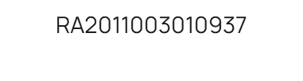
OUR TEAM
PRIYAL MITTAL
DHRITI SINGH
ARPITA SINGH
VAIDEHI JADHAO
KNB SAI HITESH
RA2011003010958
RA2011003010954
RA2011003010933
RA2011003010943

Slide 3
ABSTRACT
The aim of this project is to create a small scale computer network design for a small business.
The organization hosts an e-commerce website on a server.
This website is accessible to users using http and public ip addresses.
The network is designed with necessary hardware and software components.

Slide 4
TABLE OF CONTENTS
01
02
03
04
MODULES
INTRODUCTION
IMPLEMENTATION
ADVANTAGES & APPLICATIONS
An overview of the design and requirements of the project
The different components of the organization
Methodology adopted for the design of the network

Slide 5
INTRODUCTION
The computer network infrastructure is the backbone of the business. All devices, applications, softwares and most of your work is supported by or built upon computer networks.
To build a computer network for the company, you need to be quite careful as making a computer network run efficiently in a business environment is very different from setting up home or domestic network.
As we are dealing with 100 users, we will use LAN as our type. For the purpose of this project, our organization is based on a small scale clothing store with an e-commerce website.

Slide 6
MODULES
HEAD OFFICE
Admin
HR
Finance
Marketing
Accounting
Management
Logistics
CLOUD
E-COMMERCE SERVER

Slide 7
MODULES
HEAD OFFICE
Consists of a router and switch that integrates all the functioning departments in the business as well as allows the departments to access back end data by connecting to the cloud server.
Manages all the inter department communication and keeps record of all the departments.
It is also responsible for setting up new servers, monitoring them and maintaining them.

Slide 8
MODULES
ADMIN
HR
Controller and moderator of the network, identifies problems as they arise and come up with practical solution. Keep network up to date and ensures that it works as intended specifically maintain different networks
PCs and printers set up for the HR department on the second floor

Slide 9
MODULES
FINANCE
MARKETING
ACCOUNTING
Network set up for the finance-related activities. Two PCs allocated for this department
Network set up for communications and sales by independent representatives
Professional services network set up for providing employees resources to assist the customers in the business.

Slide 10
MODULES
CLOUD
MANAGEMENT AND LOGISTICS
E-COMMERCE SERVER
PC’s, printers and server set up for inter department communication and inventory management
Server to provide buying and selling goods and services functionality to a small number of users using https protocol
Provides network interconnectivity between cloud based or cloud enabled applications, services and solutions.

Slide 11
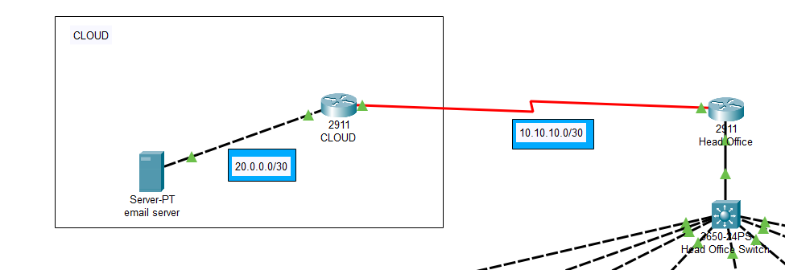
IMPLEMENTATION

Slide 12
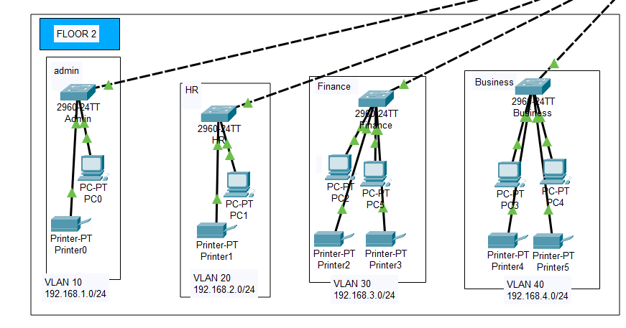
IMPLEMENTATION

Slide 13
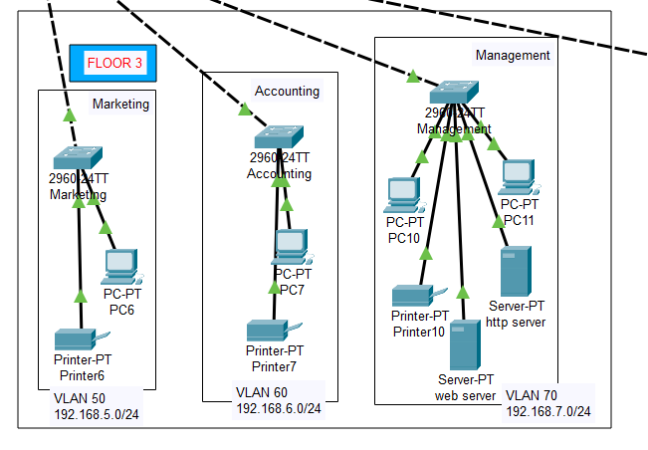
IMPLEMENTATION

Slide 14
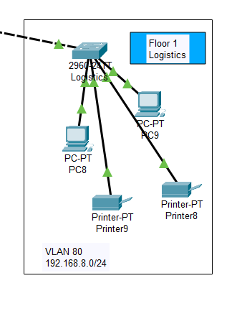
IMPLEMENTATION

Slide 15
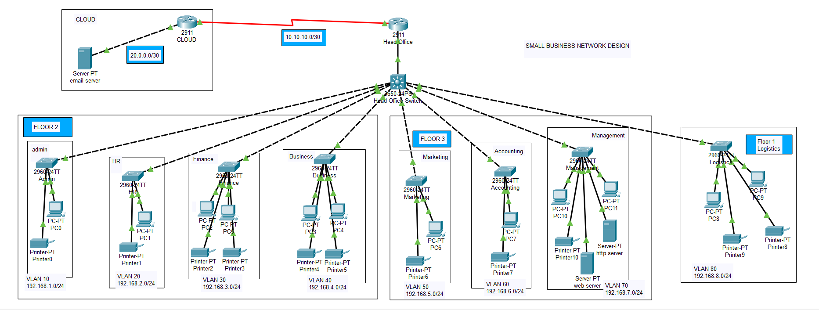
IMPLEMENTATION

Slide 16
ADVANTAGES
Reduced Cost
Improved Performance
Customized Solutions
Better Business Continuity
Enhanced Network Security

Slide 17
APPLICATIONS
Access to remote information
Person-to-person communication
Interactive entertainment
Electronic commerce
Resource Sharing

Slide 18
CONCLUSION
An appropriate small business network design is important for business owners. A small network is often more susceptible to viruses and spyware than larger networks, due to software vulnerabilities. Up-to-date software built to manage these risks is just as important as having high quality routing system and hardware.

